Slide 1
What is Logistic Regression?
Logistic Regression is a classification algorithm used to predict binary outcomes (e.g., Yes/No, 0/1, Spam/Not Spam).
It models the probability that a given input belongs to a particular class using the sigmoid function.
Scenario | When to Use? | Why Use It?
Binary Classification | When the target variable has only two outcomes (e.g., Yes/No, 0/1) | Predicts the probability of belonging to a class using the sigmoid function
Linearly Separable Data | When a straight line can separate the two classes | Provides a simple and interpretable decision boundary
Probability Estimation | When you need to estimate how confident the model is in its prediction | Outputs probabilities between 0 and 1, useful for decision-making
Low Computational Cost | When you need a fast and efficient model for classification | Requires less computing power than complex models like SVM or Neural Networks
Interpretability Needed | When you need to understand feature importance | Provides clear coefficients that show how each feature affects the prediction

Slide 2
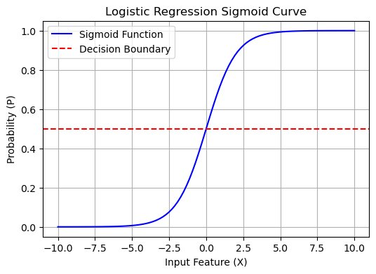
What is Sigmoid function and how it works in logistic regression?
The sigmoid function is a mathematical function used in logistic regression to transform any real-valued number into a probability between 0 and 1. It ensures that the output of logistic regression is a valid probability score.
How Does It Work?
Takes input z (a linear combination of features & weights).
Applies the sigmoid formula, squashing z into a range between 0 and 1.
Interprets output as a probability:
If S(z)>0.5S(z) > 0.5S(z)>0.5 → Class 1 (Positive Class)
If S(z)<0.5S(z) < 0.5S(z)<0.5 → Class 0 (Negative Class)

Slide 3
How does the Logistic Regression for Binary Classification works and What are the properties of Binary Classification ?
Steps of working of Logistic Regression
In logistic regression, the predicted outcome is binary, meaning it follows a Bernoulli distribution. This fits perfectly with logistic regression’s goal of classifying data into two categories.
The maximum likelihood method is used to find the best-fit parameters for a logistic regression model. In other words, it adjusts the model to match the data it has seen best, which helps make accurate predictions.
Instead of using R squared like in linear regression to measure how well the model fits the data, logistic regression algorithms use concordance. Concordance assesses how well the model ranks the predicted probabilities.
Step | Explanation
1. Data Preparation | Clean and preprocess data
2. Compute Linear Combination | Calculate z=b0+b1X1+...+bnXn
3. Apply Sigmoid Function | Convert z into probability P(Y=1)
4. Define Decision Boundary | Classify based on threshold (e.g., 0.5)
5. Train Model | Learn optimal parameters using Maximum Likelihood
6. Make Predictions | Predict probabilities & assign class labels
7. Evaluate Model | Use accuracy, confusion matrix, AUC, etc.

Slide 4
What are the Assumptions of Binary Classification ?
Assumption | Description | How to Check? | Solution if Violated
Binary Target Variable | Outcome variable must be 0 or 1. | Check unique values in target. | Use multinomial logistic regression for multi-class.
Linear Relationship (Log-Odds) | Features should relate linearly to log-odds. | Use logit plots. | Apply polynomial terms or log transformation.
No Multicollinearity | Features should not be highly correlated. | Check VIF (>5) or correlation matrix. | Remove/merge correlated variables.
Sufficient Sample Size | More data is needed for MLE stability. | Check observations per feature. | Collect more data if necessary.
No Extreme Outliers | Outliers can distort the model. | Boxplot, Z-score, IQR. | Winsorization, log transformation.
Independent Observations | No correlation between observations. | Durbin-Watson test for time-series. | Use GEE models if needed.
No Omitted Variable Bias | Important predictors should be included. | Domain knowledge, feature importance. | Add missing variables using feature selection.

Slide 5
Which Metrics to Use?
Metric | Interpretation | How to Resolve Issues
Accuracy | Percentage of correct predictions. | Use balanced datasets, consider Precision-Recall tradeoff for imbalanced data.
Confusion Matrix | Shows TP, TN, FP, FN counts. | Analyze False Positives (FP) and False Negatives (FN) to improve Precision & Recall.
Precision | Measures accuracy of positive predictions (Low FP is better). | If Precision is low, reduce False Positives using threshold tuning, feature selection, or regularization.
Recall (Sensitivity) | Measures how many actual positive cases were detected (Low FN is better). | If Recall is low, reduce False Negatives by adjusting the decision threshold, using oversampling (SMOTE) for rare classes.
F1-score | Balances Precision & Recall, useful for imbalanced datasets. | If F1-score is low, optimize both Precision & Recall by using better features, hyperparameter tuning, and resampling techniques.
ROC Curve & AUC | Measures model’s ability to distinguish classes (Higher AUC = Better). | If AUC is low, try using more informative features, non-linear models, or ensemble techniques (e.g., Random Forest).
Log Loss | Measures probability-based errors (Lower is better). | If Log Loss is high, regularize the model (L1/L2 penalties) or adjust learning rates in case of overfitting.

